Slide 1
JEWELLERY MANGEMENT SYSTEM BY VRUSHALI SUDHAKAR CHANDE

Slide 2
INTRODUCTION
Objective and Scope of project
In Jewellery shop, all the information related to stock, jewellery and customers are listed down manually using registers, files, etc.
All the availabilities, arrival of new stock of jewelleries are noted down manually in books or registers.
There is no such automated system to handle customer’s purchased history, name of the customers, stock, sales, records etc.
The main objective of the Jewellery shop management system is to manage the details of Jewellery shop, stocks, sales and vendors.
The project is fully built upon administrative end and so the administrator can only have full access to the system.
The main purpose of this project is to reduce the manual work of managing the Jewellery shop.

Slide 3
Problems
In the old system the owner used to store the data in files or books.
Keeping records in books or files may misplace and even has a great chance of getting ragged over a period of time.
It is difficult to maintain the records and creates lots of problems while searching the records.
The existing system which is currently functional in Jewellery shop is completely based on the traditional way of maintaining and managing records and details, which may get misplaced and even has a great chance of getting ragged over a period of time.

Slide 4
The proposed system has the facility of generating bills automatically. it can keep a track of all information of stock of Jewellery, sales, etc. the transactions will be executed in offline mode. it can also generate reports. so, precisely the system provides more efficient and accurate result of maintaining Jewellery stocks, customers, sales, etc.

Slide 5
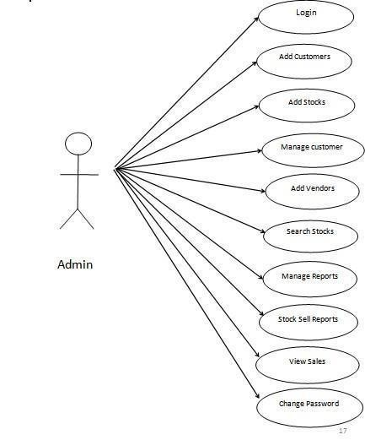
USECASE DIAGRAM

Slide 6
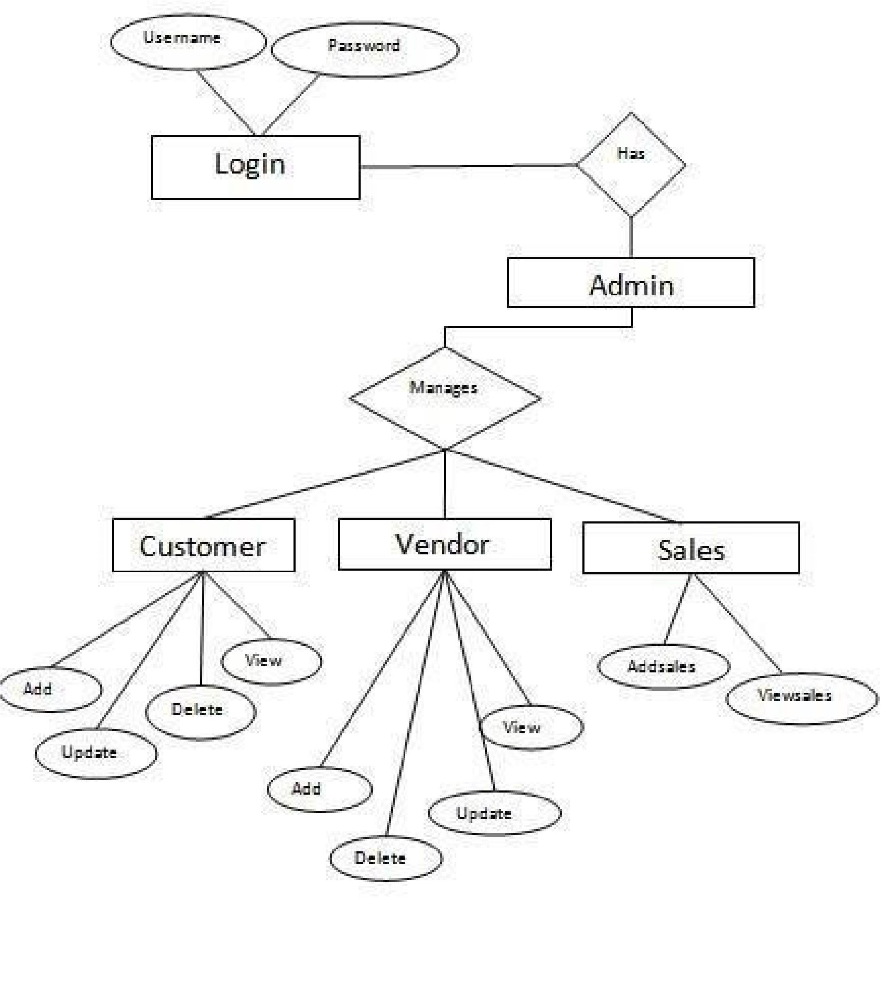
ER DIAGRAM

Slide 7
TABLE LIST
LOGIN TABLE
CUSTOMERs TABLE
USERNAME | PASSWORD
ADMIN | ADMIN
Column Name | Data type
Cust_id | Varchar(35)
Name | Varchar(35)
Address | Varchar(35)
Date | Varchar(35)

Slide 8
TABLE LIST
VENDORs TABLE
SALE TABLE
Column Name | Data type
Vendor_id | Varchar(35)
Vname | Varchar(35)
Vaddress | Varchar(35)
Vdate | Varchar(35)
Column Name | Data type
Cust_id | Varchar(35)
Name | Varchar(35)
Jewellery_desc | Varchar(35)

Slide 9
SYSTEM REQUIREMENTS
SOFTWARE REQUIREMENTS
ECLIPSE IDE
MySQL for the database

Slide 10
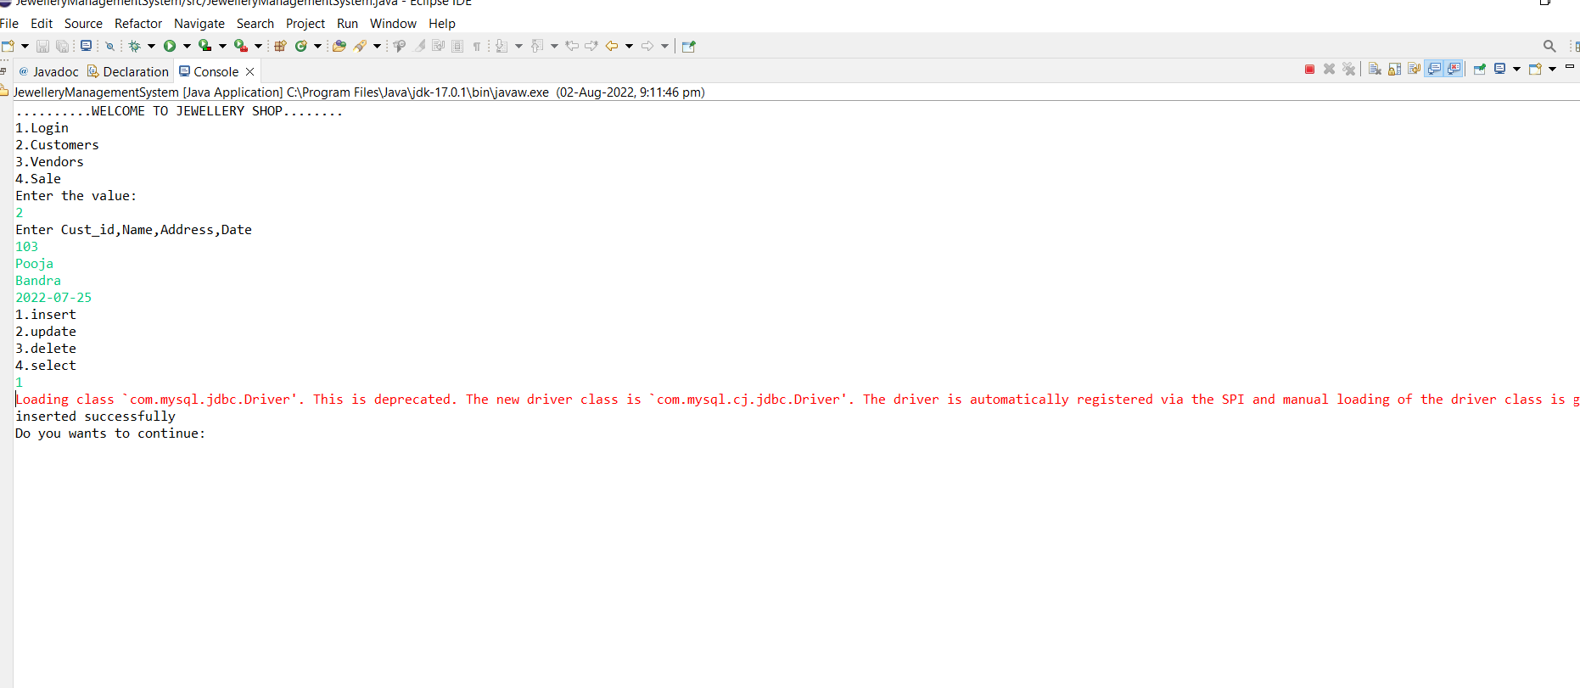
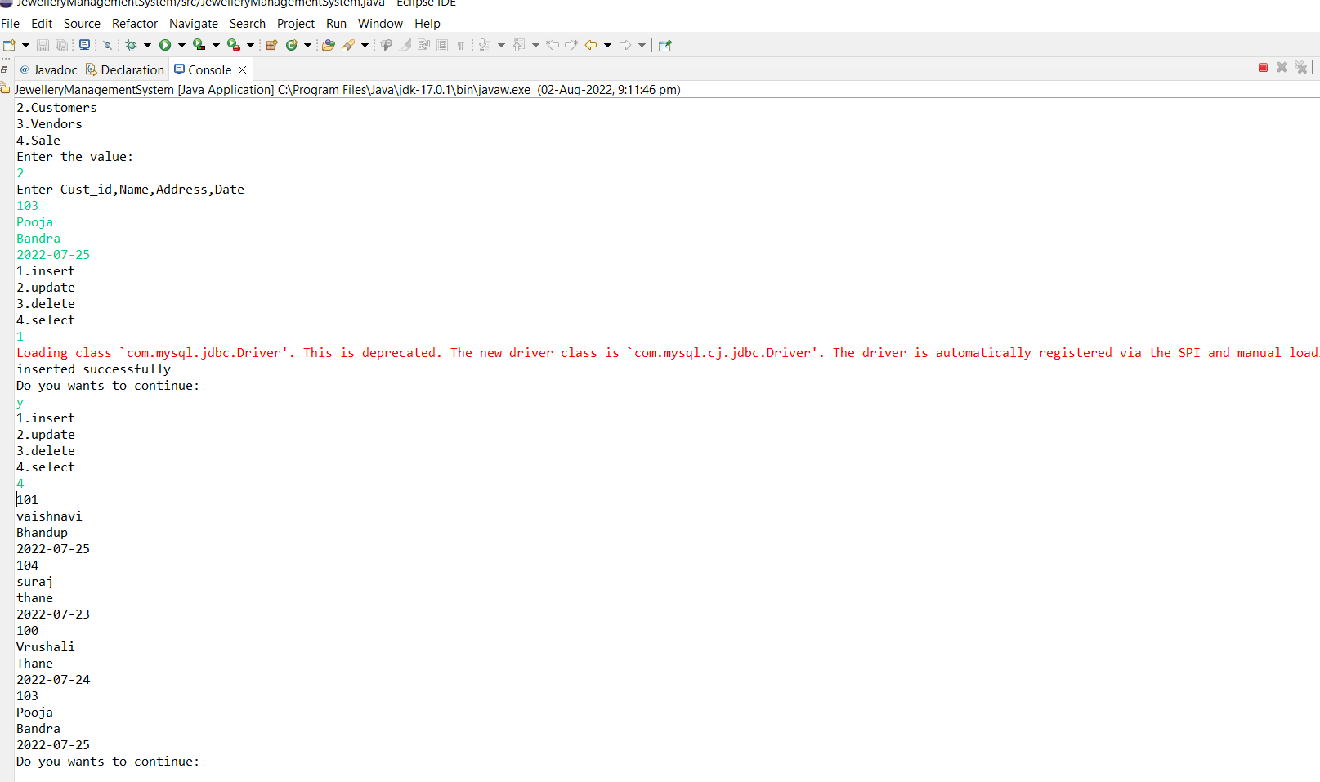
SCREENSHORTS

Slide 11
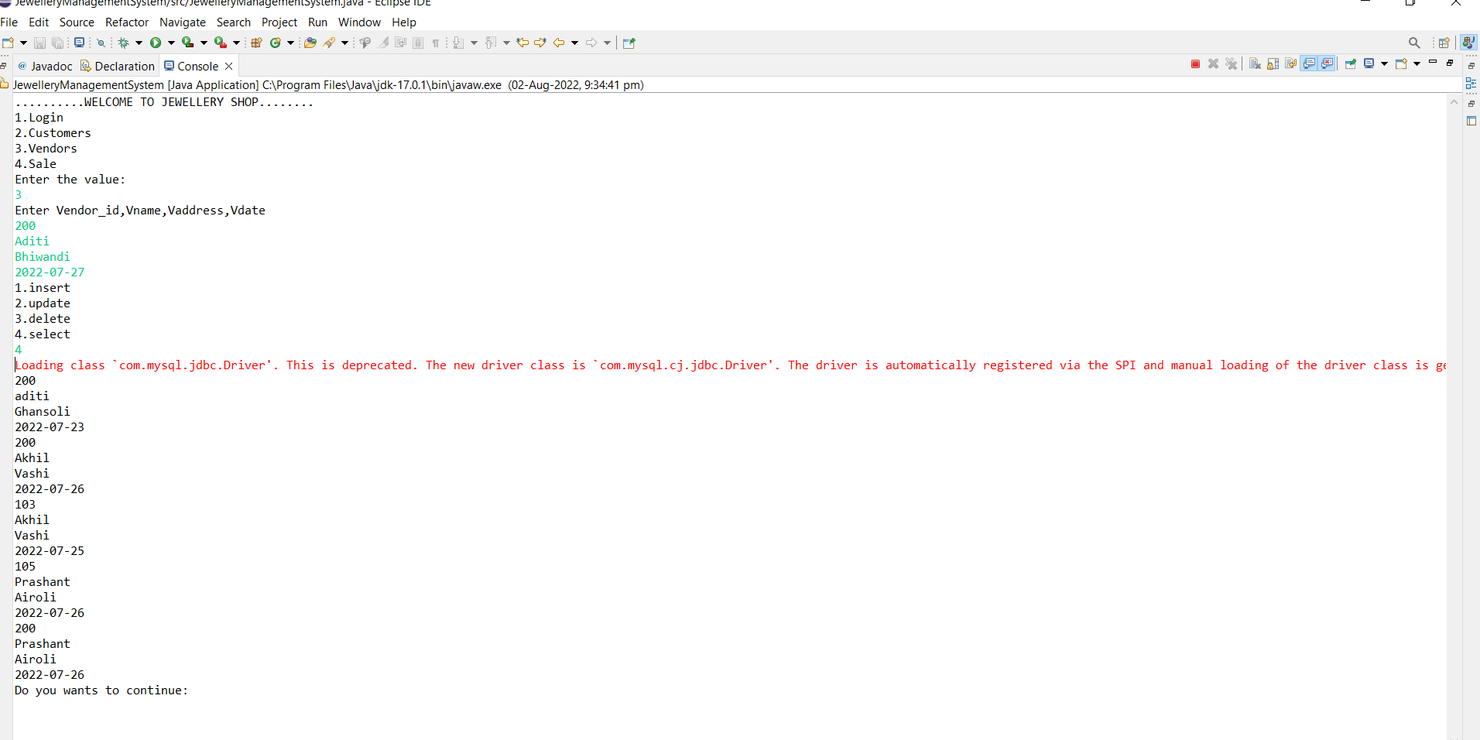
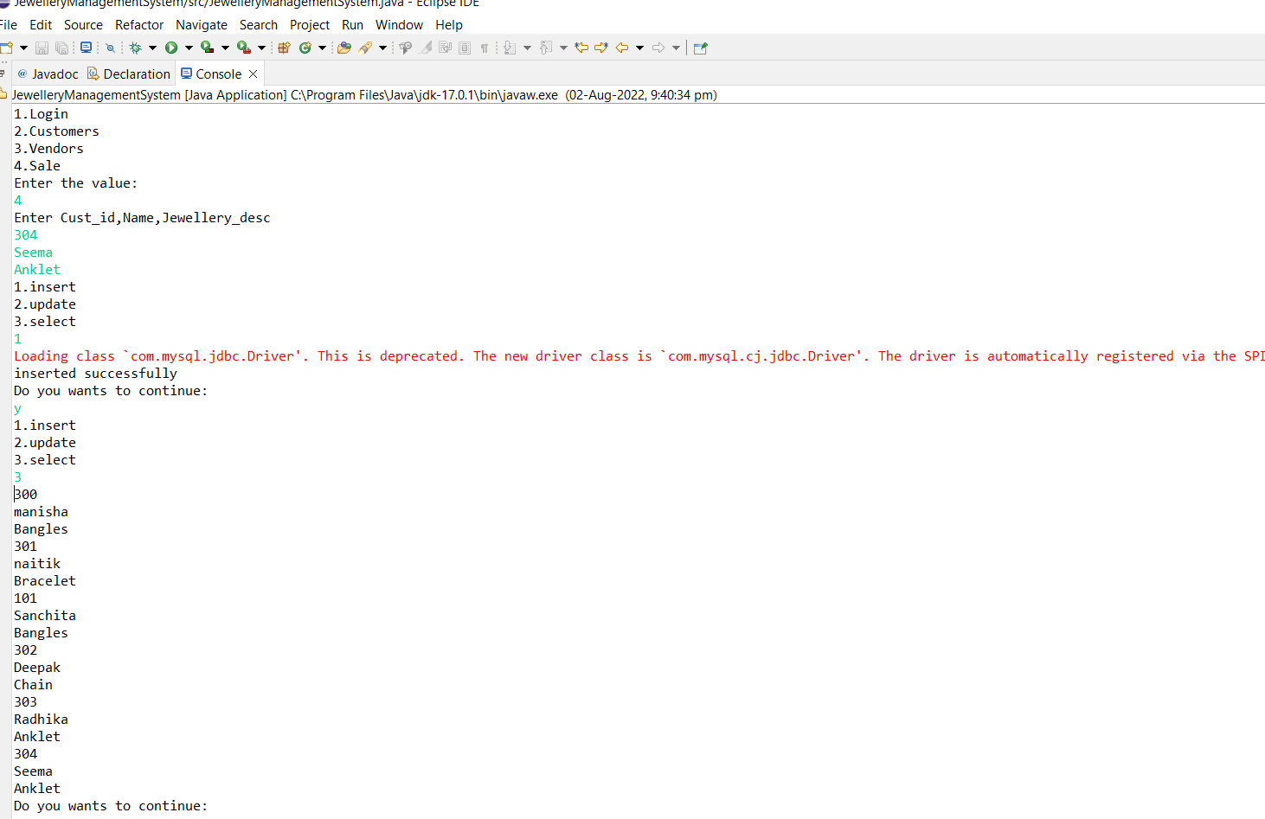

Slide 12
FUTURE ENHANCEMENT
We can give more advance software for Jewellery shop management including more functionalities.
We will host the platform on online server to make it accessible worldwide.
Implement the backup mechanism for taking backup of codebase and database on regular basis on different servers.
The software will even more secure and data will be more safe.

Slide 13
Websites /References
www.google.com

